Slide 1

DestinEase
Travel advisor App
Team: Visionary Techs
CS-691-Capstone Project

Slide 2

AGENDA
Our Team
Project Overview
Project Description
Tools and Technologies
Personas
Project Schedule
Team Working Agreement
120+

Slide 3
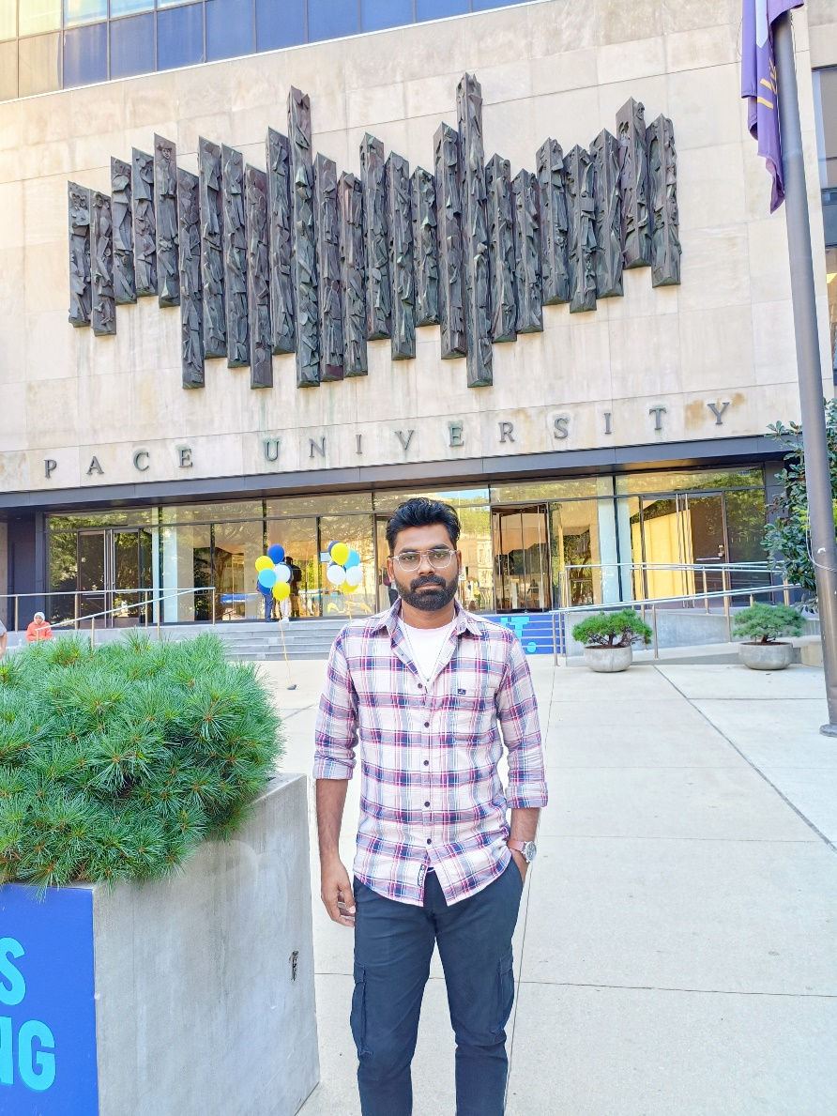
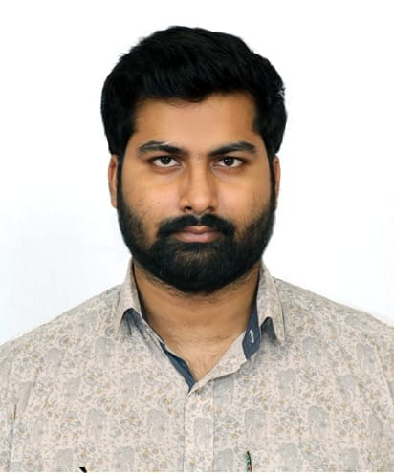
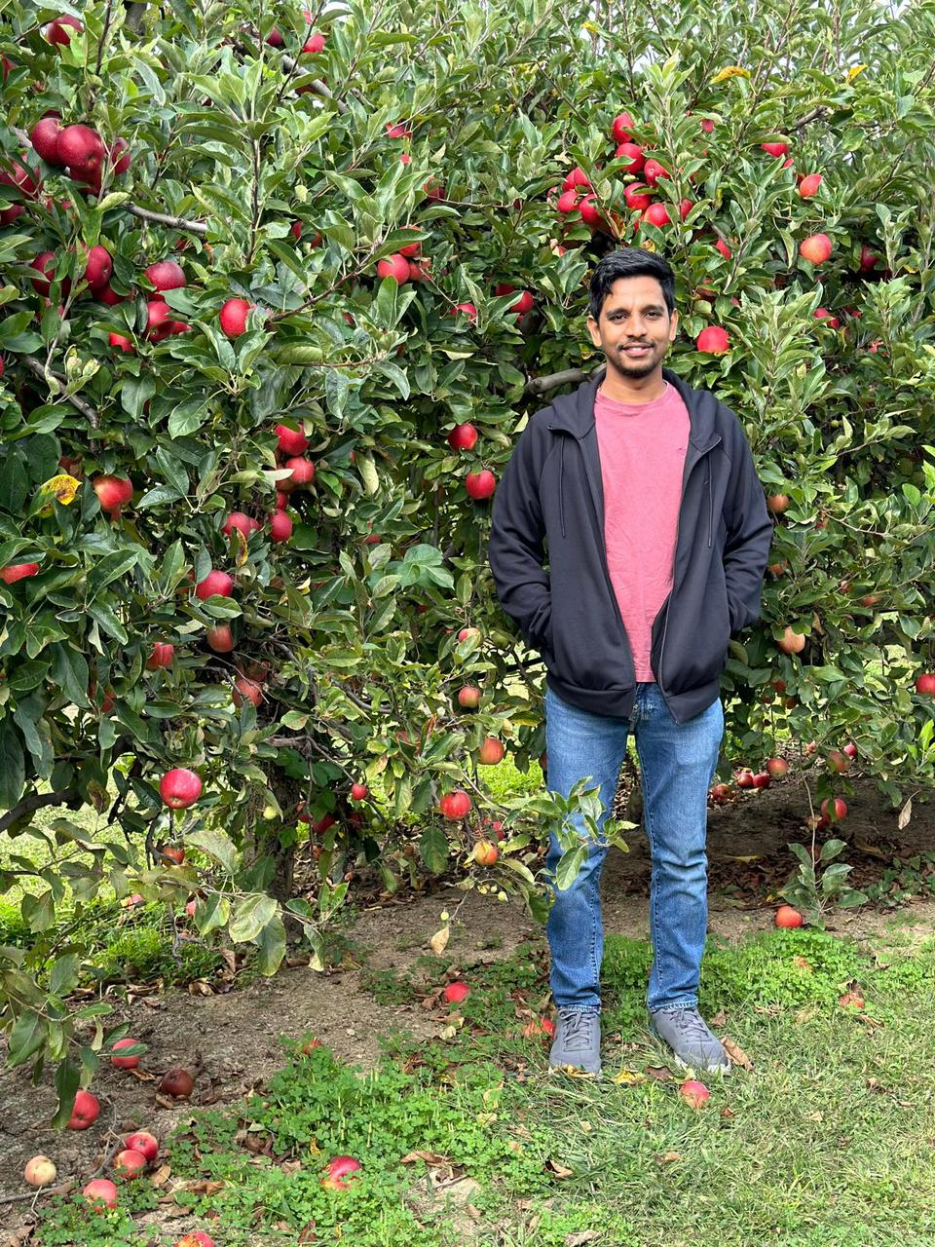
Roles and Responsibilities
Ramanjul Reddy Kotlo
Project Manager & Developer
Manish Chowdary Veeravalli
Developer and UI/UX Designer
Satheesh Bollineni
UI/UX Developer

Slide 4
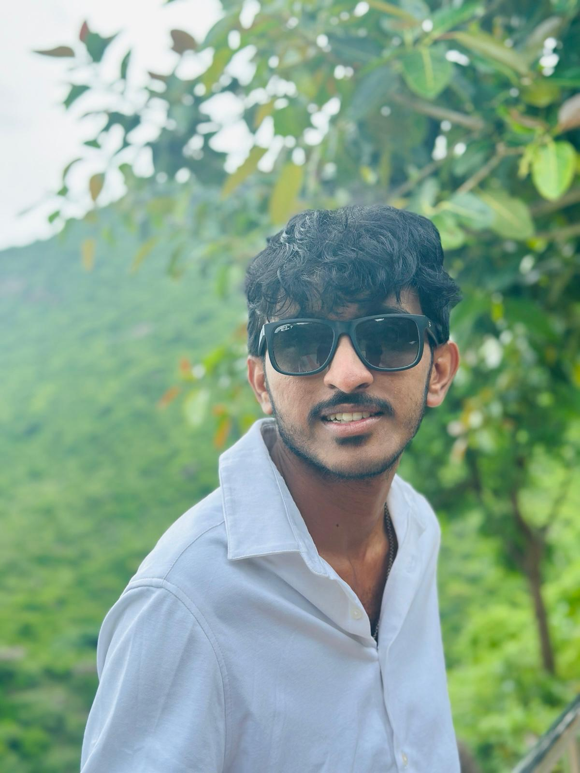
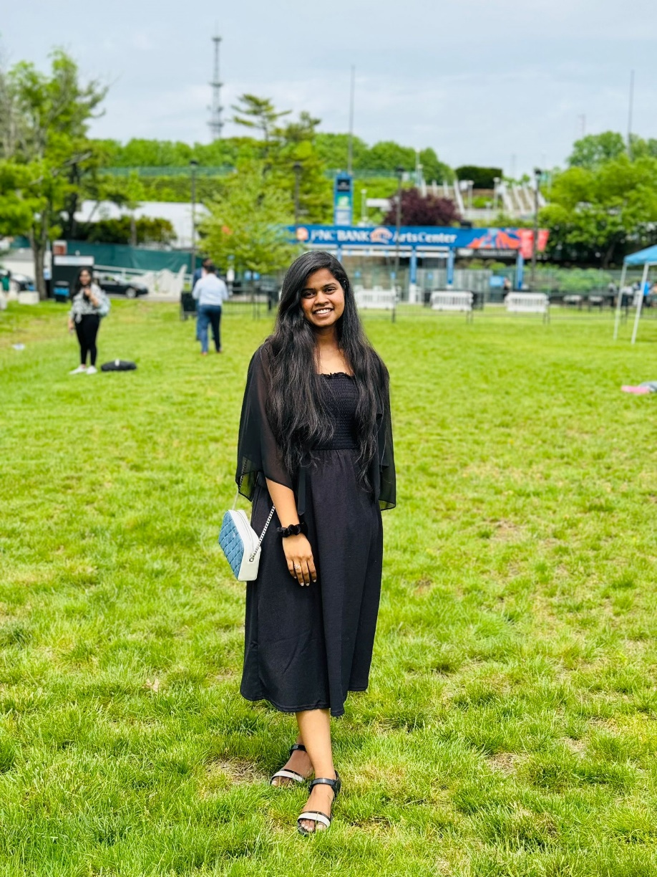
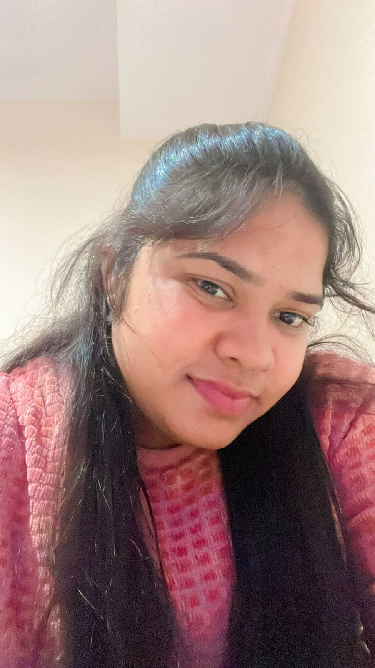
Roles and Responsibilities
Siva Naga Mahesh Kadem
Quality Assurance (QA) Tester
Srija Vanka
Developer (Frontend)
Sandhya Sri
Developer(Backend)

Slide 5
Project Overview
In today's digital age, travellers face the challenge of efficiently finding personalized travel destinations that align with their unique preferences and constraints. Existing solutions often provide generic recommendations, require time-consuming manual research, and fail to consider multiple factors simultaneously. DestinEase addresses these issues by developing an AI-driven platform that offers highly personalized travel recommendations based on user-specific criteria such as budget, weather preferences, and food interests.

Slide 6
Project Description
DestinEase is an innovative travel recommendation platform that utilizes artificial intelligence to provide highly personalized destination suggestions. The system analyzes multiple user preferences simultaneously, including budget, weather preferences, and food interests, to deliver tailored travel recommendations.
DestinEase significantly streamlines the travel planning process. It reduces the time and effort typically spent on manual research, allowing users to quickly discover ideal destinations that match their specific criteria.
The platform incorporates real-time data on weather conditions and pricing, ensuring that recommendations are always up-to-date and accurate.

Slide 7
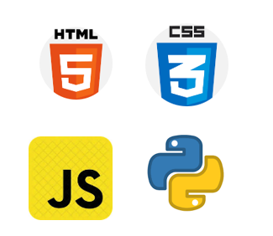


Tools and Technologies
Programming Languages and Frameworks
Other tools
Cloud and Database

Slide 8






Travel Habits:
Travels twice a year for leisure, seeking well-rounded vacations that balance adventure and relaxation.
Prefers well-planned trips with detailed itineraries, comfortable accommodations, and reliable transportation.
Often travels with family and friends, making group travel deals and suggestions important.
Uses apps for convenience and values personalized recommendations based on preferences and budget.
End-User Persona: The Practical Explorer
About
Age: 35 years
Chicago, USA
Female
HR Manager
Tech Savviness: Intermediate
Maria Johnson

Slide 9
What She Wants from the App:
Simple, easy-to-use interface with personalized recommendations for destinations, weather, and activities.
Budget tracking features to keep her within financial limits while planning a vacation.
Family-friendly suggestions for travel and dining.
Weather-based travel advice, ensuring the trip aligns with her preferred climate.
Why She Matters:
She’s a practical, frequent traveler who needs efficient travel planning solutions. Her needs reflect a large segment of users who rely on personalized, budget conscious, and well-organized recommendations

Slide 10
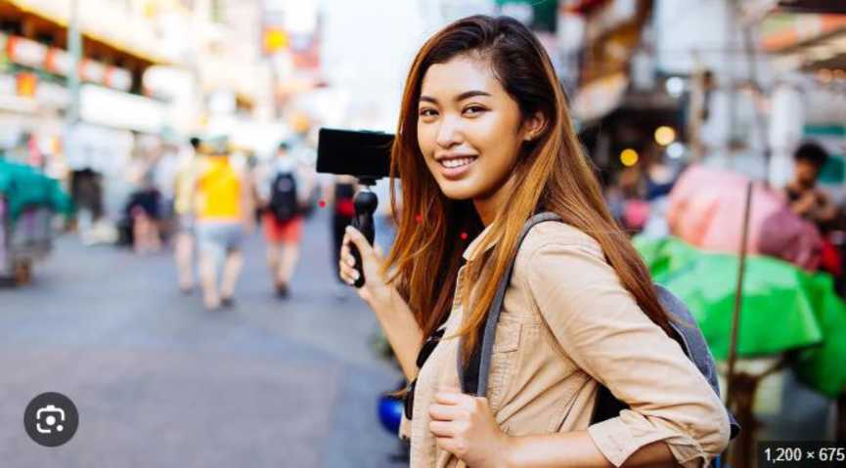
End-User Persona: The Travel Vlogger
Travel Habits:
Travels frequently to exotic locations, documenting her experiences for her YouTube channel and Instagram followers.
Seeks unique, off-the-beaten-path destinations to offer fresh content to her audience.
Often collaborates with brands for sponsored trips, so she looks for destinations that are trendy and Instagrammable.
Needs accurate weather information and affordable flights for planning content around seasonal events and festivals.
About
Age: 29 Years
Barcelona, Spain
Female
Travel Vlogger & Social Media Influencer
Tech Savviness: Advanced
Isabella Cruz

Slide 11
What She Wants from the App:
Destination recommendations based on current trends and popular social media hashtags.
Suggestions for visually appealing, photo-friendly places (e.g., natural landscapes, cultural landmarks).
Real-time flight and accommodation deals to help plan last-minute trips.
Ability to integrate with her social media platforms for easy sharing of reviews and recommendations.
Why She Matters:
As a social media influencer, her use of the app can drive brand visibility, with her audience potentially becoming users. Her recommendations could help shape travel trends among her followers.

Slide 12

Travel Habits:
Travels impulsively, usually deciding at the last minute without much planning.
Prefers to book travel through a travel agent or simple online tools without much concern for research or reviews.
Often makes spontaneous weekend trips without needing detailed itineraries or recommendations.
Doesn't care much about flight prices, weather conditions, or specific local food options.
End-User Persona: The Impulse Traveler
About
Age: 41 Years
Dallas, USA
Male
Real Estate Broker
Tech Savviness: Beginner
Steve Miller

Slide 13
What He Wants from the App:
Simple, easy-to-use interface with personalised recommendations for destinations, weather, and activities.
Budget tracking features to keep her within financial limits while planning a vacation.
Family-friendly suggestions for travel and dining.
Weather-based travel advice, ensuring the trip aligns with her preferred climate.
Why He Matters:
He is a frequent traveler who needs efficient travel planning solutions. Her needs reflect a large segment of users who rely on personalized, budget conscious, and well-organized recommendations

Slide 14

End-User Persona: The Digital Nomad
Travel Habits:
Travels frequently while working remotely, staying in destinations for 2-3 months at a time.
Values locations with reliable internet connectivity, affordable accommodations, and coworking spaces.
Prefers to immerse himself in local culture, exploring offbeat locations, food, and activities during his downtime.
Looks for flexible flight options and long-term accommodation deals.
About
Age: 33 Years
Dublin, Ireland
Male
Freelance Web Developer
Tech Savviness: Advanced
Liam O’Connor

Slide 15
What He Wants from the App:
Flexible, long-term stay suggestions in digital-nomad-friendly locations.
Destination recommendations based on reliable internet access and remote work setups.
Weather forecasts and local events to plan work and leisure activities.
Affordable flight and accommodation packages for extended stays.
Why He Matters:
Digital nomads represent a growing user base, needing specialized travel planning for long-term stays with work-friendly setups. Catering to their needs opens up opportunities for expansion into the remote work travel market.

Slide 16
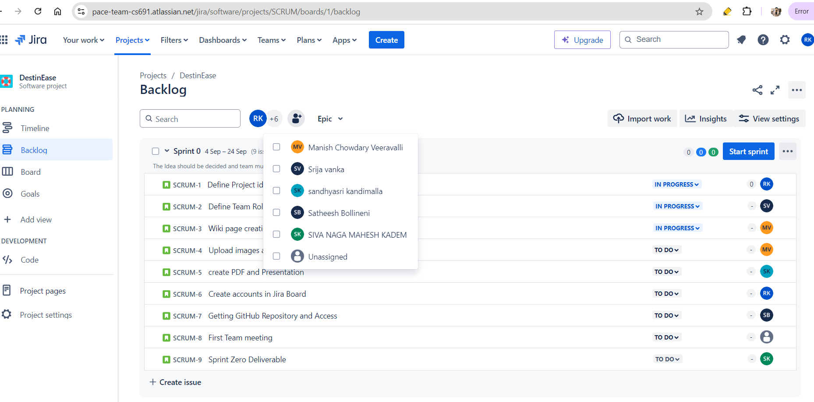
Project Schedule

Slide 17
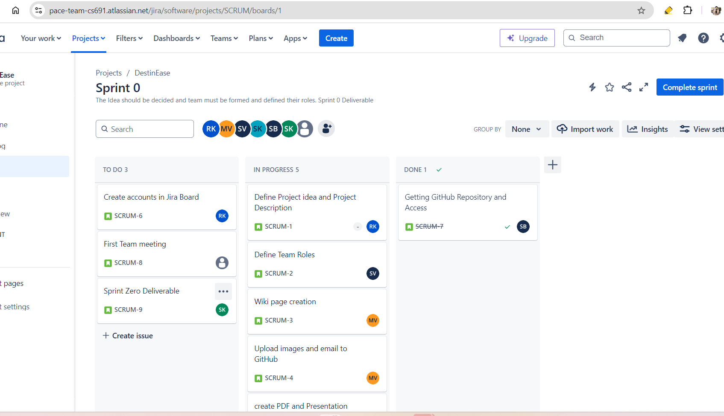
Project Schedule

Slide 18
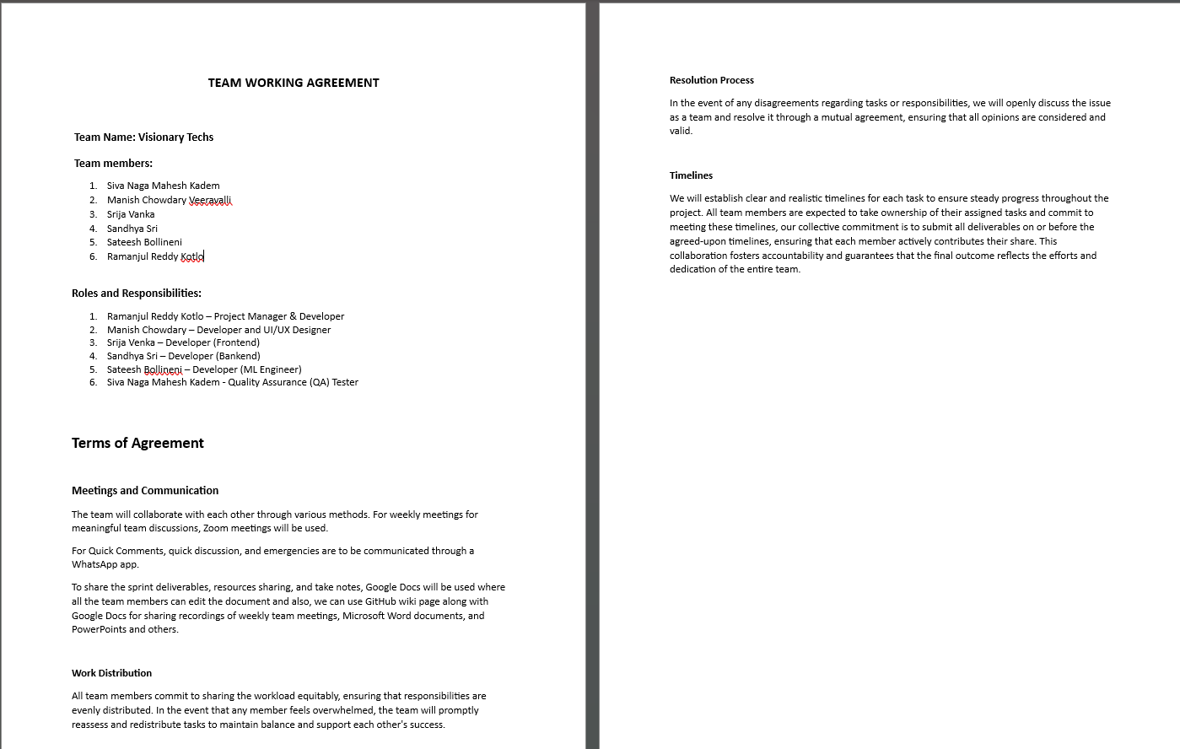
Team Working Agreement

Slide 19
Wiki page link
https://github.com/htmw/2024F-Visionary-Techs/wiki

